Slide 1
1 Getting ready to listen
Listening Skills

Slide 2
Getting ready to listen
In this unit you will practise:
understanding the context
listening for specific details
using correct spelling
understanding numbers

Slide 3
Getting ready to listen-Understanding the context
1 Understanding the context
In the introduction to the Listening section you will be told who the people are what they are talking about and why. This information is called the context. It helps you understand the topic. It is not written on the question paper.

Slide 4
Getting ready to listen-Understanding the context
1. Understanding the context
After the introduction you will be given a short time to look at the questions. Studying the questions before you listen can help you predict what the speakers will talk about.

Slide 5
Getting ready to listen-Understanding the context
1.1 You are going to hear the introductions of four IELTS Listening sections. Before you listen, try to predict the context by reading the questions in the table below. Choose FOUR answers from the box and write the correct letter A-F in the table.

Slide 6

Getting ready to listen-Understanding the context
2
section | Listening test questions | context
1 | Total number of guests: _______ Susie will organise invitations and ____ | C
2 | What type of gift does the speaker recommend for a child's birthday?
E
3 | The students chose this topic because A they have a lot of information about it. B they would like to learn more about it. C they think they will get a higher mark.
4 | Aim: To assess the impact of loss of habitat on native animals Methods: Calculate the current numbers of native animal species . Study their movements by attaching __
E
B
D
Contexts
A shopping for food B discussing an assignment
C organising a party D describing a research project
E buying presents F explaining how something works

Slide 7
Getting ready to listen-Understanding the context
1.2 Listen again. Decide how many speakers you will hear in each of these sections. Try to write down who the speakers will be.
1 two speakers (a man and his daughter)
2 one speaker (a woman)
3 three speakers (two students and their lecturer)
4 one speaker (a student)

Slide 8
Getting ready to listen- Using the correct spelling
2 Using the correct spelling
In Listening Section l, you may need to listen for the name of a person or a place. Often, the names will be spelt out for you. You need to recognise the letters of the English alphabet well, so that you can write the letters you hear quickly. You will only hear the spelling once.
Any spellings that you hear will be in the context of a normal conversation, so you need to be able to hear the difference between letters and words.

Slide 9
Getting ready to listen- Using the correct spelling
3
2.1 Listen and write the letters you hear.
1 ________________ 4 ________________
2 ________________ 5 ________________
3 ________________
F
T, C
LL
CH, SH
M

Slide 10
Getting ready to listen- Using the correct spelling
4
2.2 There are several ways to help you spell a word。Listen to five short conversations and complete notes 1-5with NO MORE THAN ONE WORD AND / OR A NUMBER.
1 Name: Mr Andrew __________
2 Address: 63 __________ Road, Birmingham
3 Website address: www. _________ .com
4 Meet at the _________ Hotel
5 Registration number: ___________
Browne
Beeton
kickers
Rose
HLP 528

Slide 11
Getting ready to listen- Using the correct spelling
4
2.3 Listen again and complete extracts a-f from the conversations.
Conversation 1
a. Is that ____________________ colour?
b. Yes, but __________________.
Conversation 2
c. Sorry, __________________ N or M?
Conversation 3
d. That’s right, ___________________ lower case.
spelt the same as the
with an E at the end
was that last letter
all one word and all

Slide 12
Getting ready to listen- Using the correct spelling
Conversation 4
e. Oh, it’s the Rose Hotel, _______________.
Conversation 5
f. It’s just ____________________________.
It’s HLP 528
like the flower
three letters and three numbers
Study Tip Practise saying the letters of the English alphabet. “For example, spell words out for a friend to write down.

Slide 13
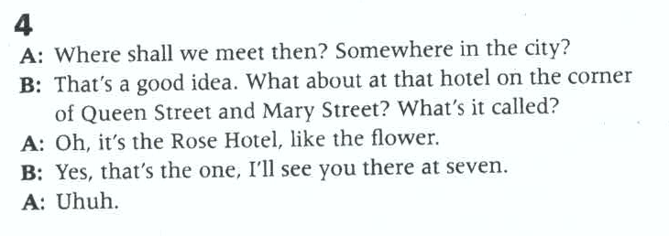
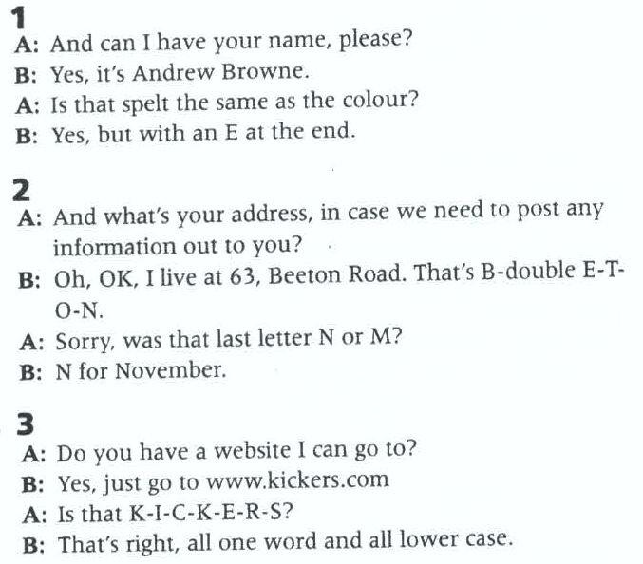
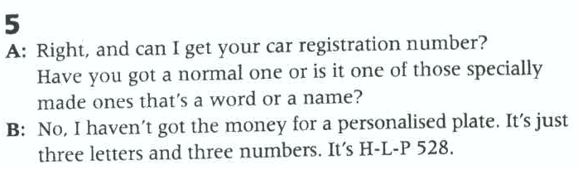
4

Slide 14
Getting ready to listen- Writing numbers
5
3. Writing numbers
In Section 1 of the Listening paper, you need to listen for specific details.
3.1 Listen and circle the number you hear in each pair (a-j)
a 1st / 3rd f 15 / 50
b $10. 50 / $10.15 g 52 / 62
c 6th / 5th h 110 / 810
d 17 / 70 I 31st / 33rd
e 19 / 90 j 22nd / 27th
3.2 Listen again and practise saying the numbers.

Slide 15
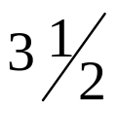
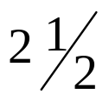
Getting ready to listen- Writing numbers
6
3.3 Listen and complete the information below.
1. How much does the woman pay for her room? ￡______
2. new students need to bring $ ______
3. Garage width: ________in height: ________ in
4. How much does the woman pay for the bus tickets?
A $25 B $55 C $75
5. Party date: ___________________________
95
15
3.5
2.5
29th July / 29 July / 29.7 / 7.29

Slide 16
Getting ready to listen- Writing numbers
6
3.4 Listen again and write the other numbers you hear and the reason they are incorrect.
conversations | Other numbers | reasons
1 | ￡80 | this is the amount she paid last time
 | ￡105
2 | $10 | this is what regular students pay
 | $5 | this is the extra fee charged for equipment
this is the full price

Slide 17
Getting ready to listen- Writing numbers
3 | 1.5 (metres)
 | 1 (metre)
 | 3 (metres)
4 | $25
 | $45
5 | 14th July
 | 1st August
this is the width of his car
this is how much space you need between cars
this is the height he would prefer
this is a child’s fare
this is an adult’s fare
this is the first available date
this is her father’s birthday

Slide 18
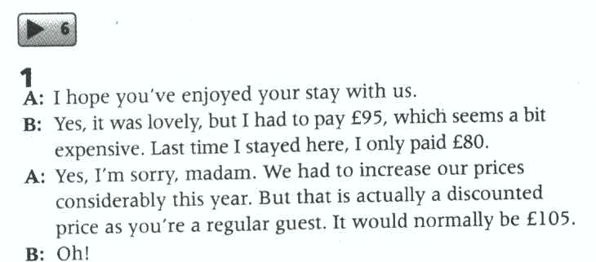



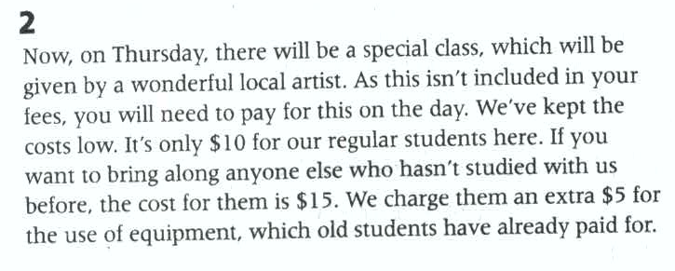




Key information

Slide 19
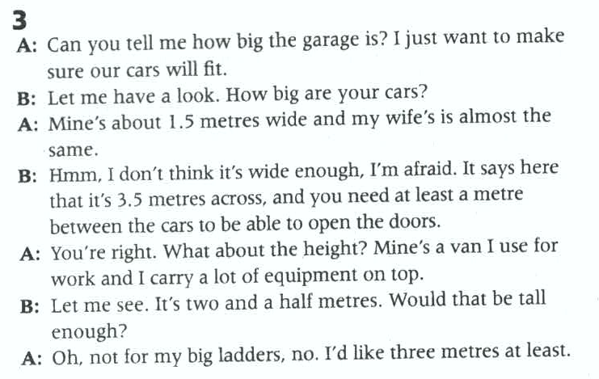






Slide 20
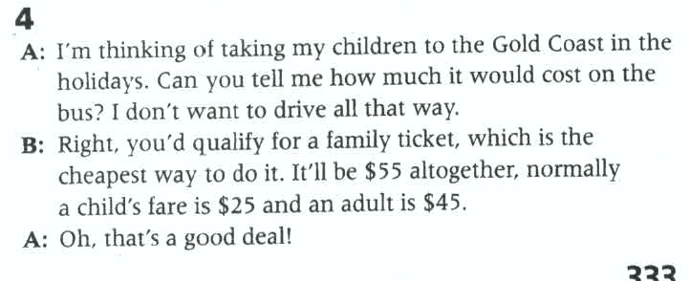





Slide 21
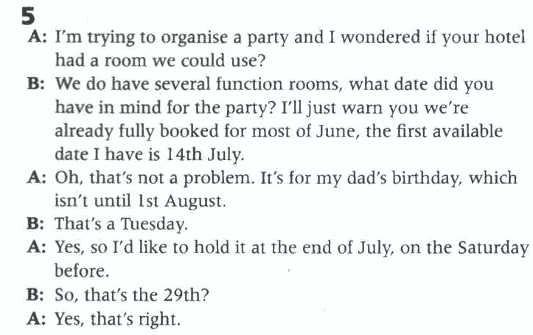





Slide 22
Getting ready to listen- Writing numbers
7
3.5 Listen to extracts from four different talks and choose the correct answer (A, B or C). Also please write down numbers related to each talk.
1. The survey found that the majority of students drink _______.
A. water. B. coffee. C. tea.
2. What point does the speaker make about skiing?
A. A small percentage of the US is suitable for skiing.
B. A surprisingly large number of Americans like skiing.
C. A relatively small proportion of Americans have tried skiing.
3. The number of wild elephants in Africa is estimated to be at least
A. 53,000. B. 470,000. C. 690,000.
4. According to the speaker, which two can weigh the same?
A. the tongue of a blue whale and an elephant
B. an elephant and a blue whale
C. a bus and an elephant

Slide 23
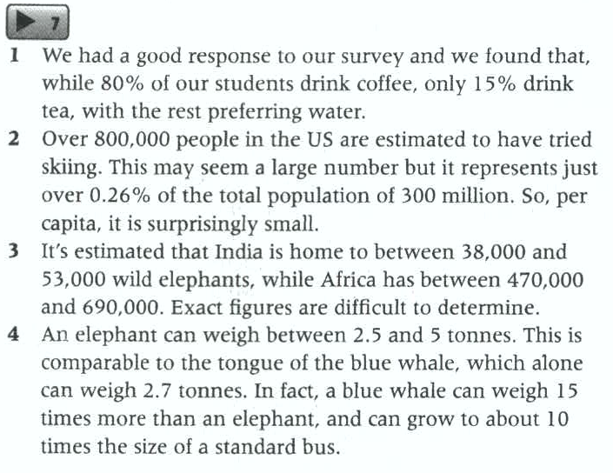








7

Slide 24
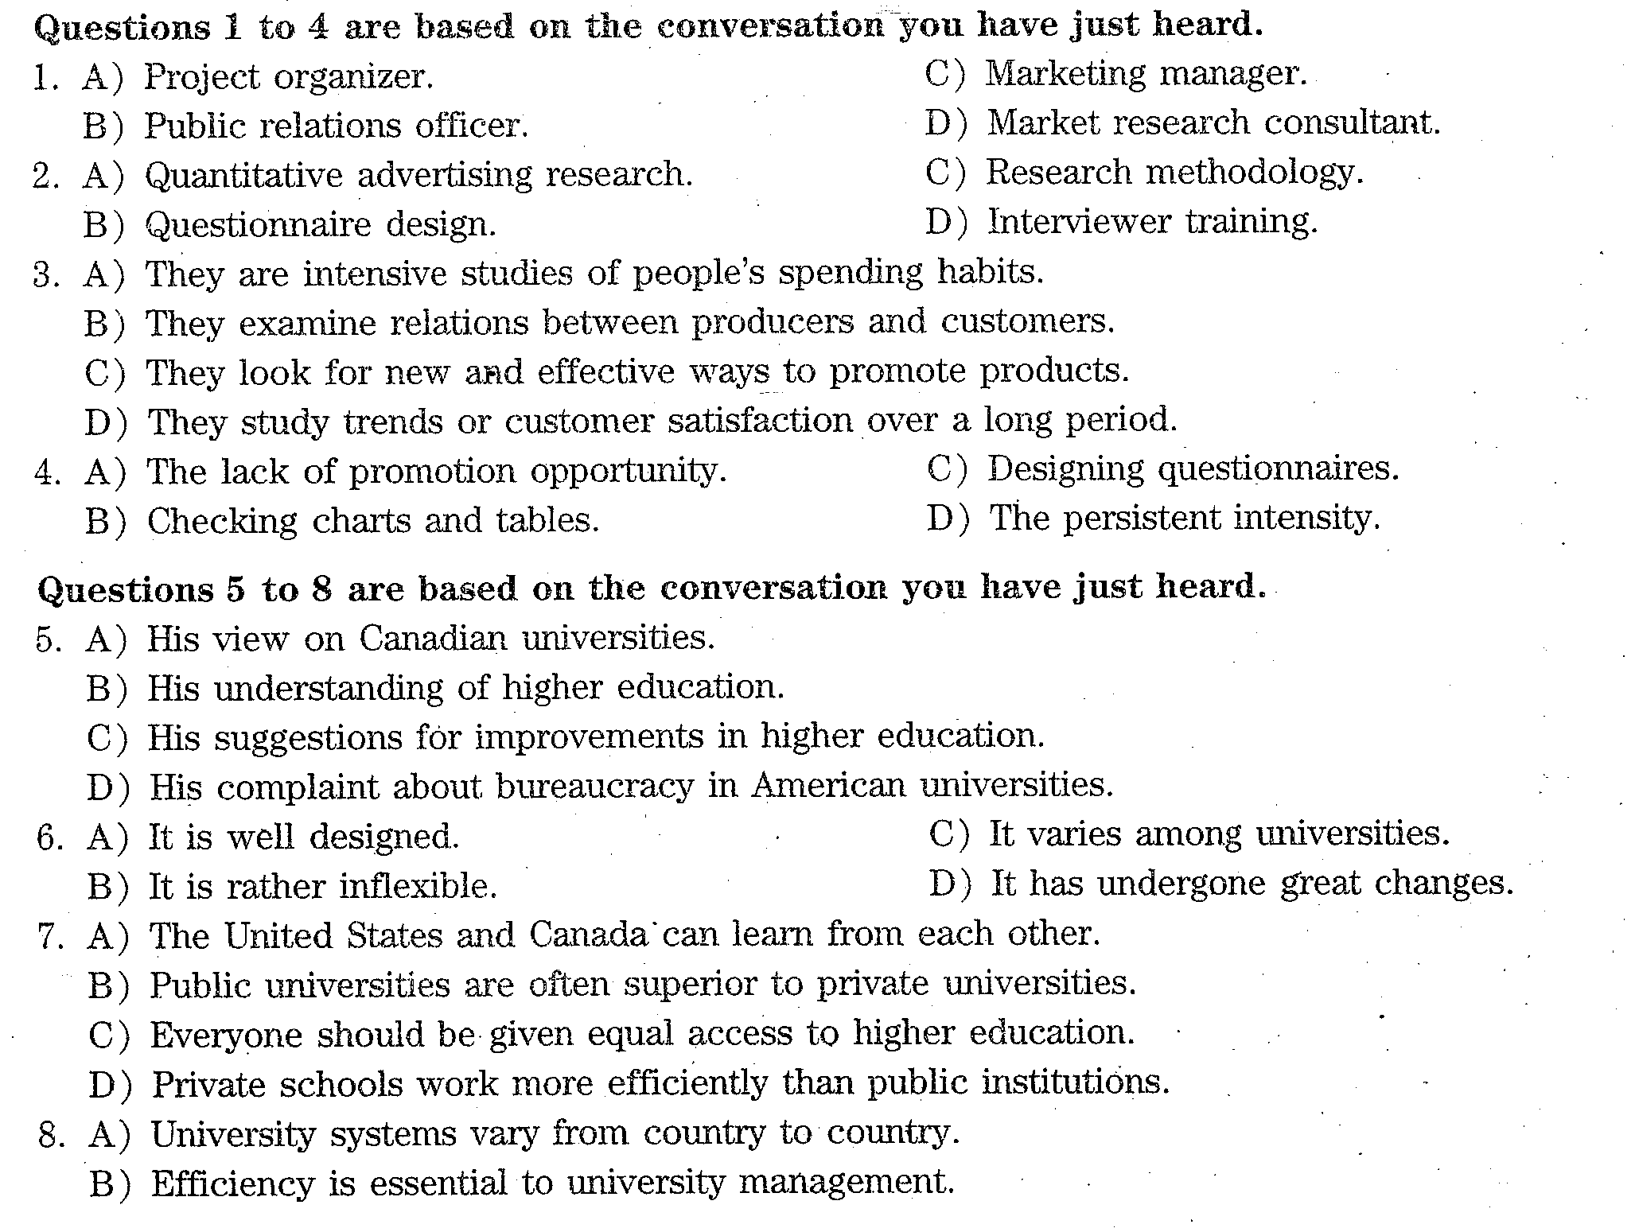
2016.6六级真题（第一套）

Slide 25

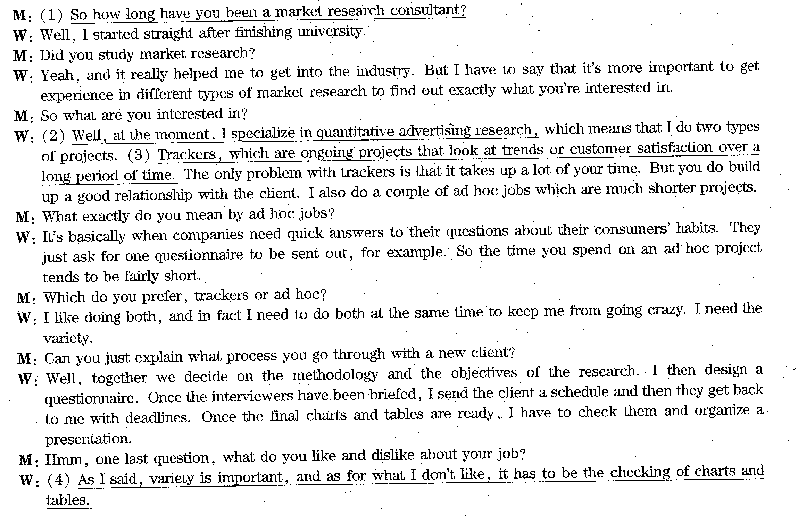











原义再现，同义转换，重复，关键词

Slide 26
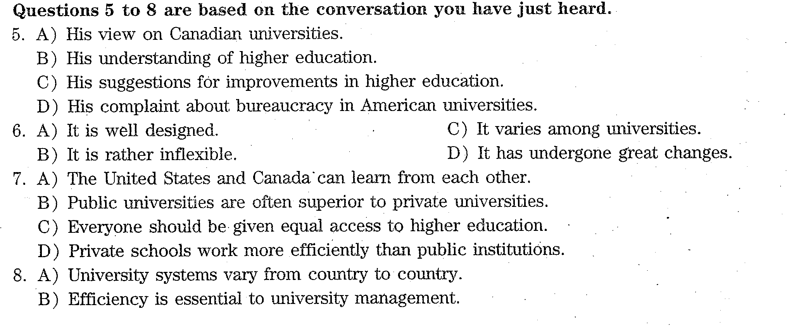

Slide 27
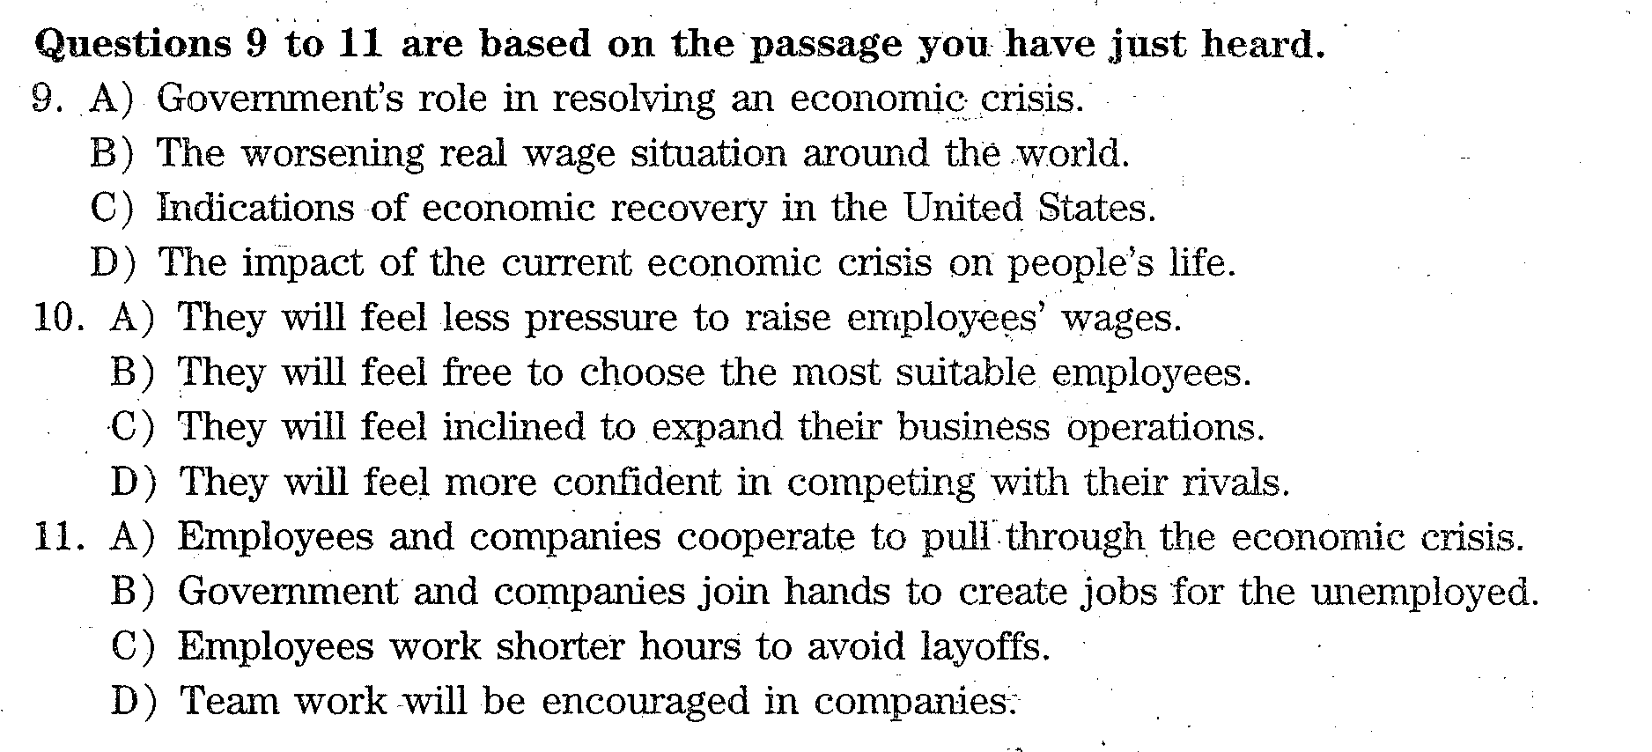
Short passage 1

Slide 28
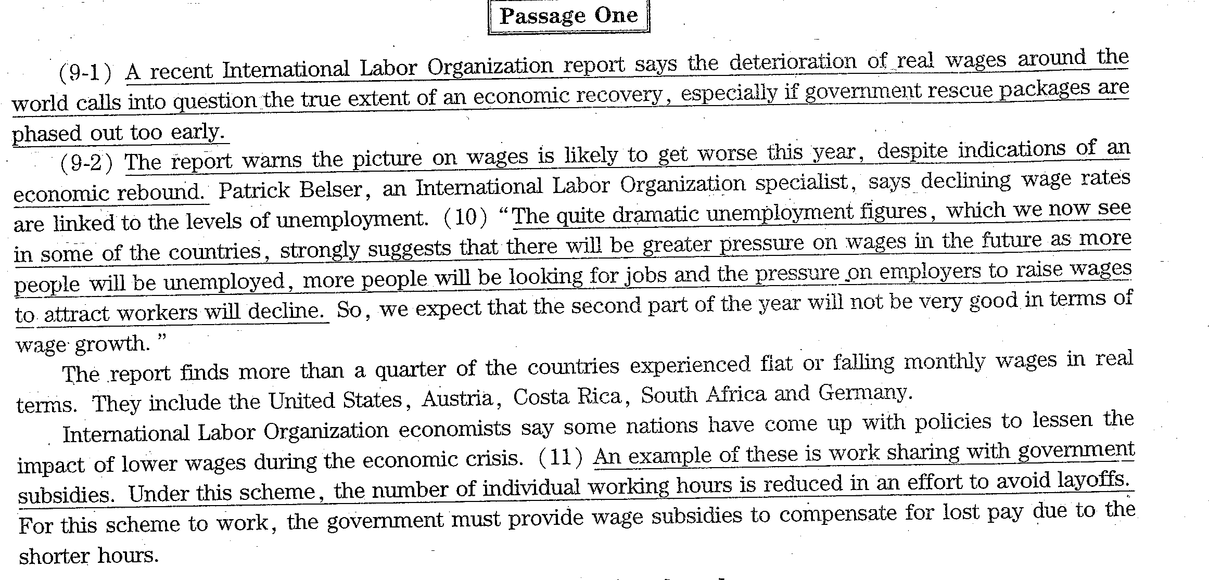













重读，重复读，强调

